Slide 1
Taipei Chapter Activity Report
Chair: Ding-Bing Lin
July 25-29, 2016

Slide 2
IEEE EMC-S Taipei Chapter
Advisory Committee
Executive
Committee
Technical Committee
EMC Management
EMC Measurement Techniques
EMC Standards and Regulations
Smart Grid and High Power EMC
System-Level EMC and Protection
Transportation EMC
Antenna and Wave Propagation
Electronic Packaging EMC and SI
Semiconductor Device and IC EMC
Signal Integrity and Power Integrity
Wireless Communication EMC
Computational Electromagnetics
Bio-Medical Electromagnetics
ESD

Slide 3
Taiwan Electromagnetic Industry-Academia Consortium (TEMIAC)
EMC
Chapter
AP
Chapter
TEMIAC
MTT
Chapter
CPMT
Chapter

Slide 4
Chapter Annual Activities

Slide 5
Host City: Taipei

Slide 6
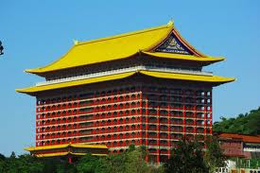
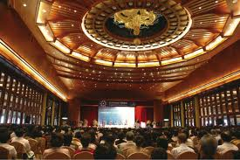
Venue: The Grand Hotel

Slide 7
APEMC 2015
May 25-29, 2015
More than 400 attendees
More than 200 regular and special session papers to present
More than 20 workshops and tutorials
First full-day workshop for Distinguished Lectures of EMC Society
Technical tours of TSMC & ARTC
Exhibitions

Slide 8
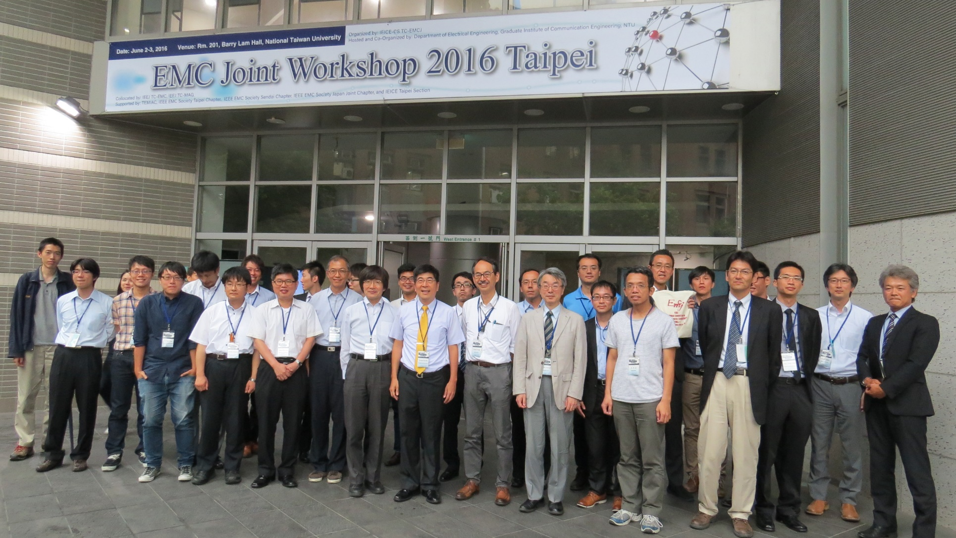
EMCJ Workshop 2016
Date: June 2-3, 2016 Venue: National Taiwan University

Slide 9
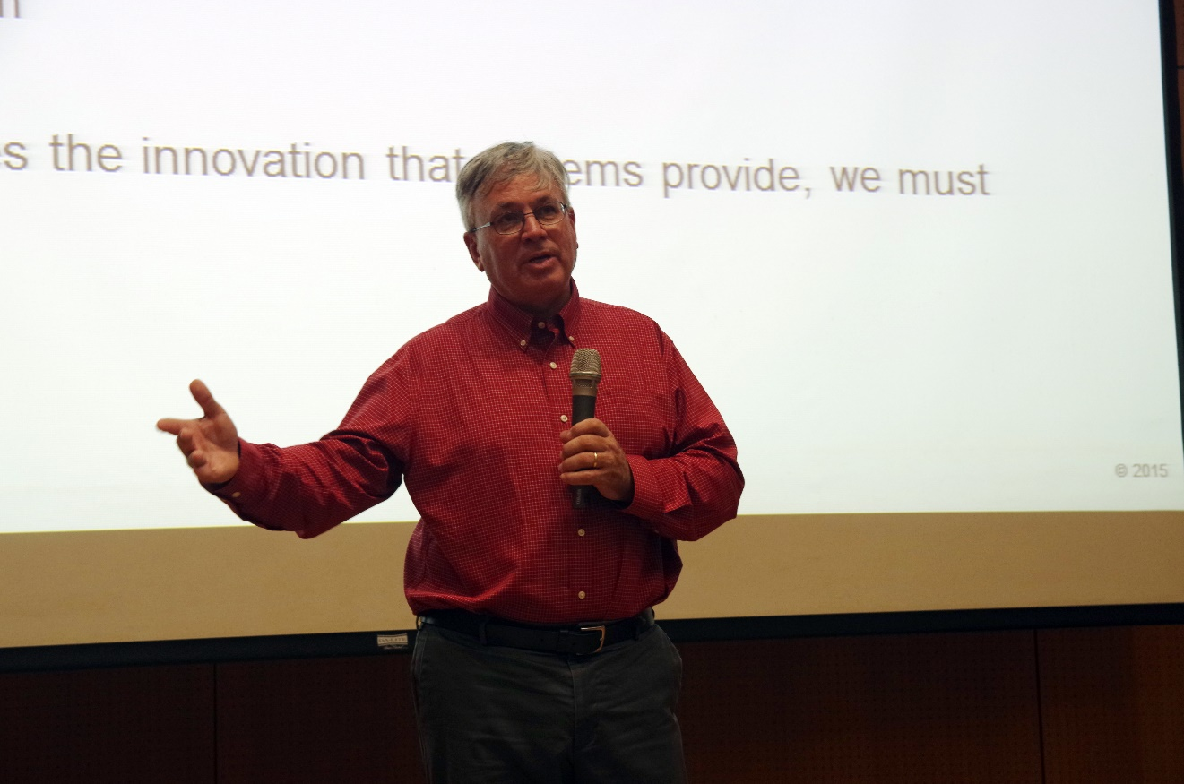
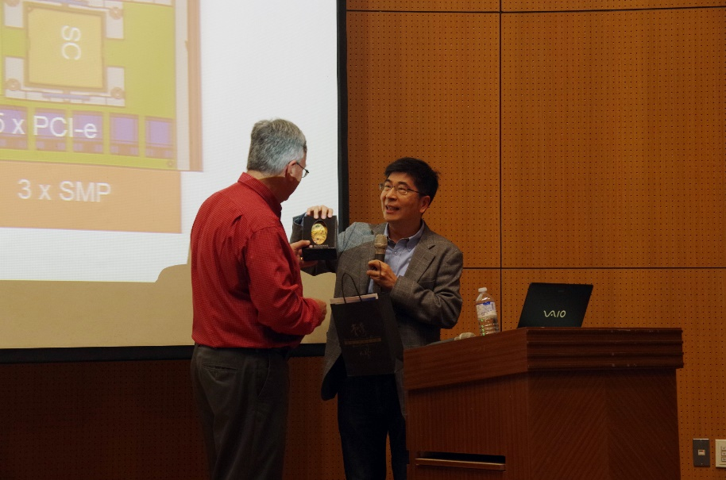
Technical Meeting
Date: Dec. 9, 2015
Topic: Considerations for Advancing Technology in Computer System
Packaging
Presented by IEEE Distinguished Lecturer: Dr. Dale Backer, IBM USA

Slide 10
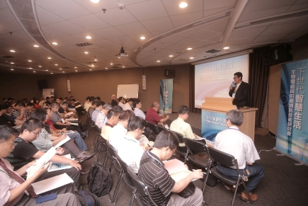
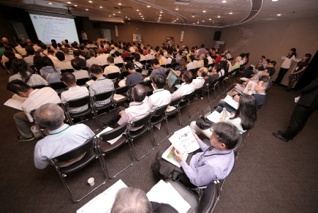
EMC Workshop
Next Generation Smart Life, Bio-EM, and Advanced Communications Technology
Date: May 30, 2016 Guest Attendance: more than 300
Supported by Auden Tech. Corp.

Slide 11
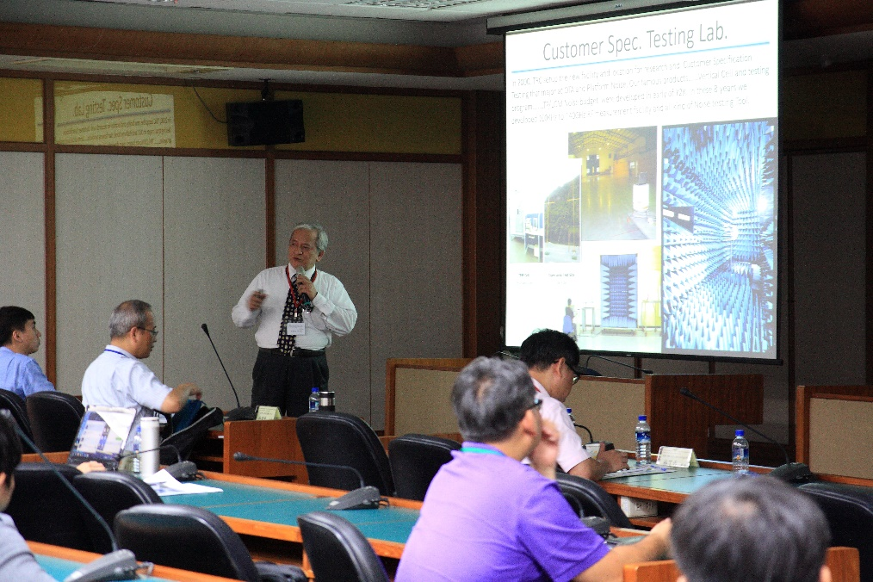
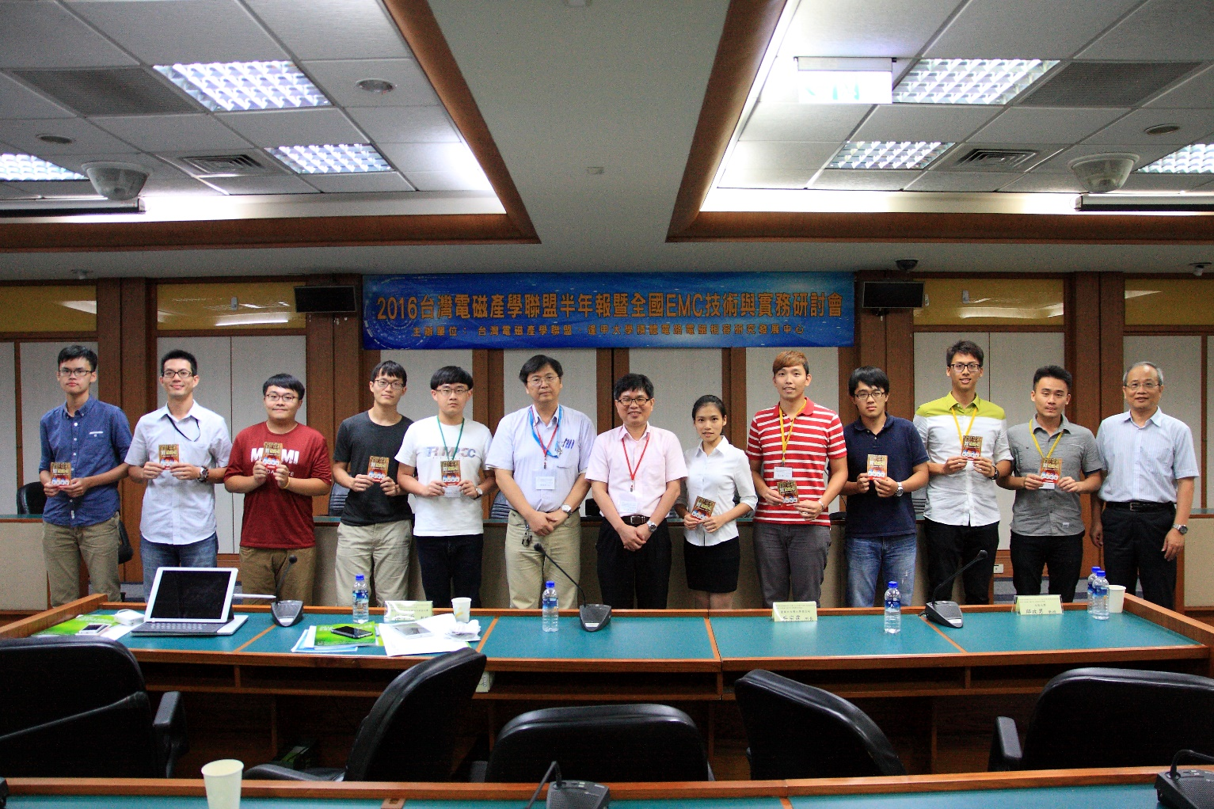
2016 Taiwan EMC Technology and Practice Symposium
Date: June 23-24, 2016
Venue: Feng Chia University

Slide 12
Thank You for Your Attention

